Slide 1
Dynamics & Control 3 CONTROL
Section 4.2c:
Compensators
Dr. Olaoluwa R. Popoola
Email: Olaoluwa.popoola@glasgow.ac.uk
Notes adapted from Dr. Henrik Gollee’s notes + A.Gulliver (U Victoria)

Slide 2
Objectives / Prerequisites
Objectives:
Definition of compensators
Impact of LEAD, LAG and LEAD-LAG compensators
Prerequisites:
Closed-loop system definition

Slide 3
Introduction

Slide 4

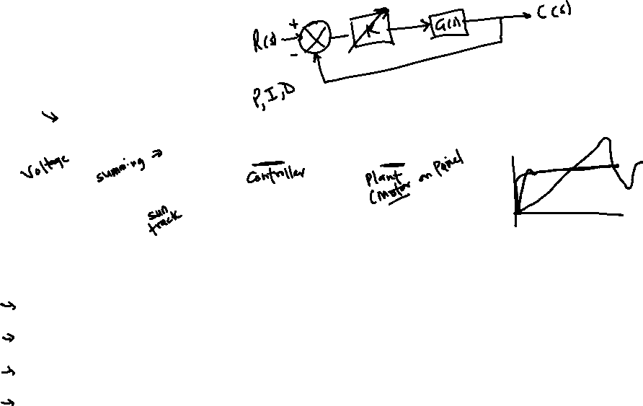
Controller
Closed-loop system
Controller H(s) can be:
Simple gain: $Kp$
An integrator: $H\left(s\right)=\frac{K_{i}}{s}$
A differentiator: $H\left(s\right)=K_{d}s$
PID

Slide 5
Controller Design
Sometimes the job of the control system designer is simply to choose an appropriate value of controller gain, K.
But often a compensator network is required to reshape the Nyquist locus.
Note that
criteria 1, 2, 3 and 5 depend on the high-frequency behaviour of the system (i.e., the part of the Nyquist locus near the -1 point)
whereas 4 depends on the low-frequency behaviour.
Compensators are often designed to leave one part of the locus unchanged, while having a significant effect on the important part of the locus where the uncompensated system is unsatisfactory.
Notes:
Slim down this slide or, at minimum, highlight the key information.
Add somewhere the three types of compensators we are going to cover.

Slide 6
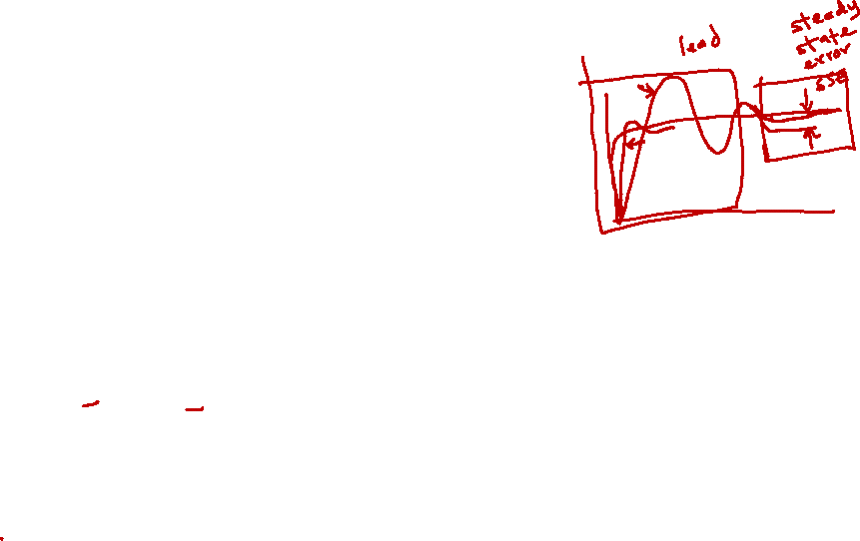
Types of compensators
There are three main types of compensators:
LEAD compensator
Improve transient response
LAG compensator
Improves the steady-state performance at the expense of slower setting time.
LEAD-LAG compensator
Combine advantages of both LEAD and LAG.

Slide 7
LEAD Compensators

Slide 8
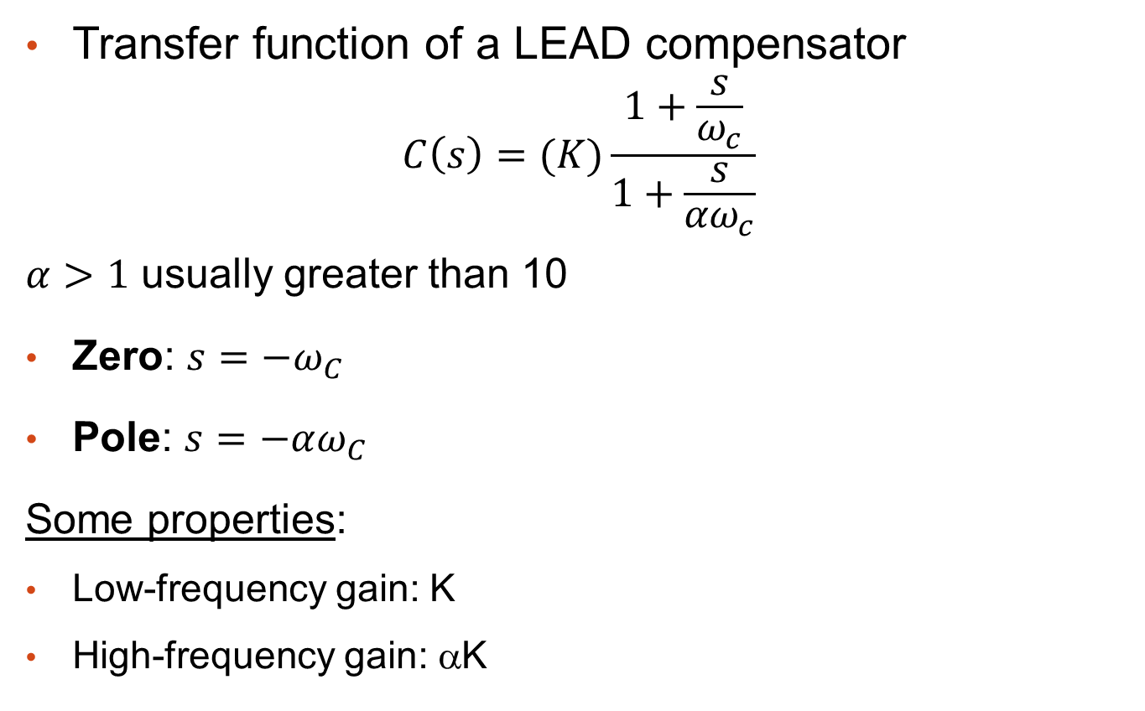
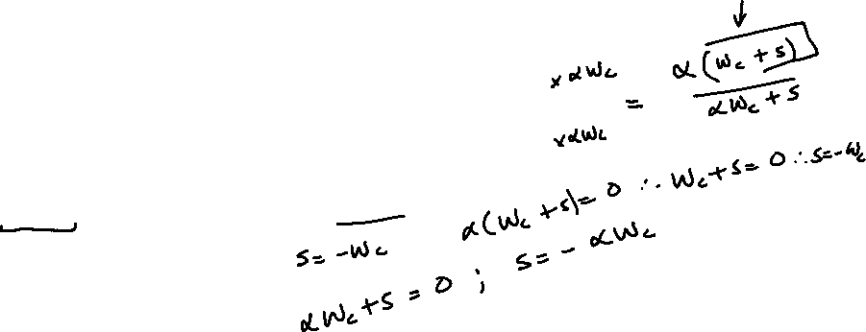
LEAD: Definition
Transfer function of a LEAD compensator
$$C\left(s\right)=(K)\frac{1+\frac{s}{ω_{c}}}{1+\frac{s}{{αω}_{c}}}$$
$α>1$ usually greater than 10
Zero: $s=−ω_{C}$
Pole: $s=−αω_{C}$
Some properties:
Low-frequency gain: K
High-frequency gain: αK
Notes:
OK

Slide 9
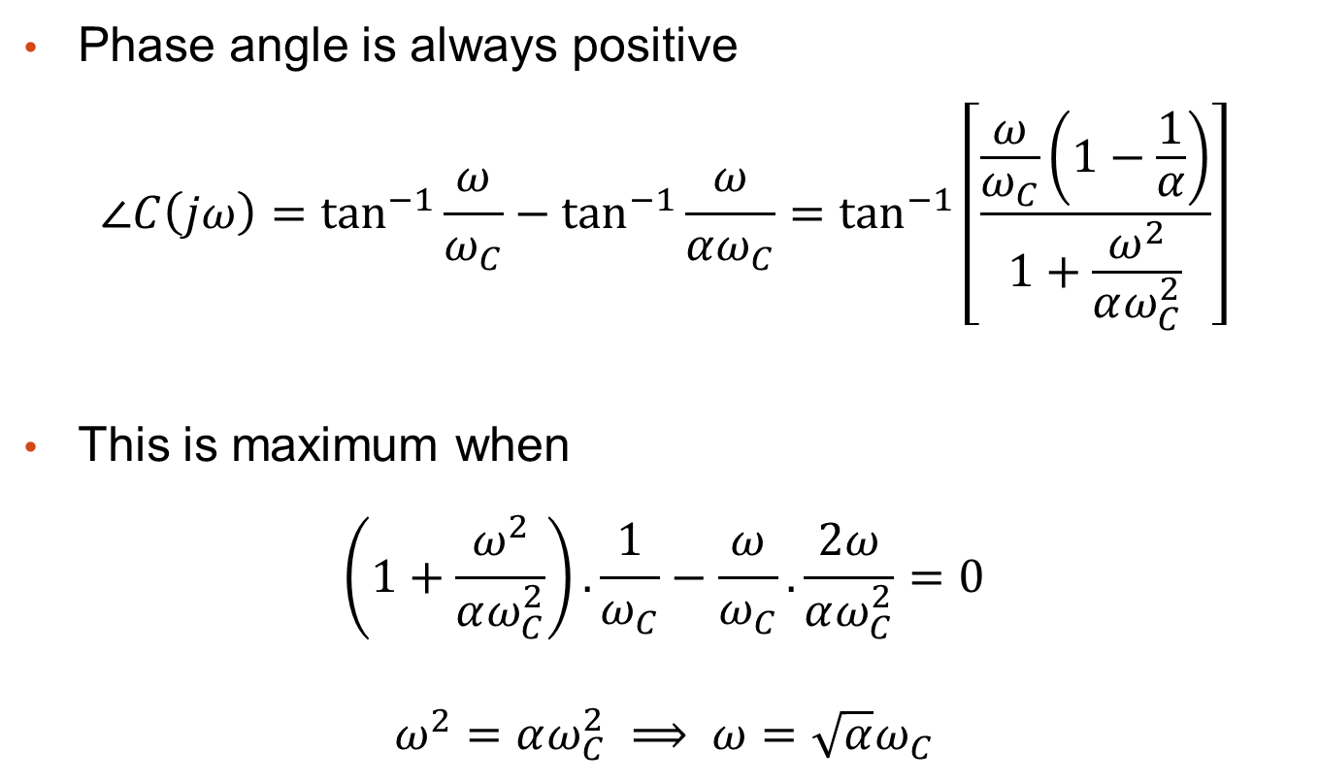
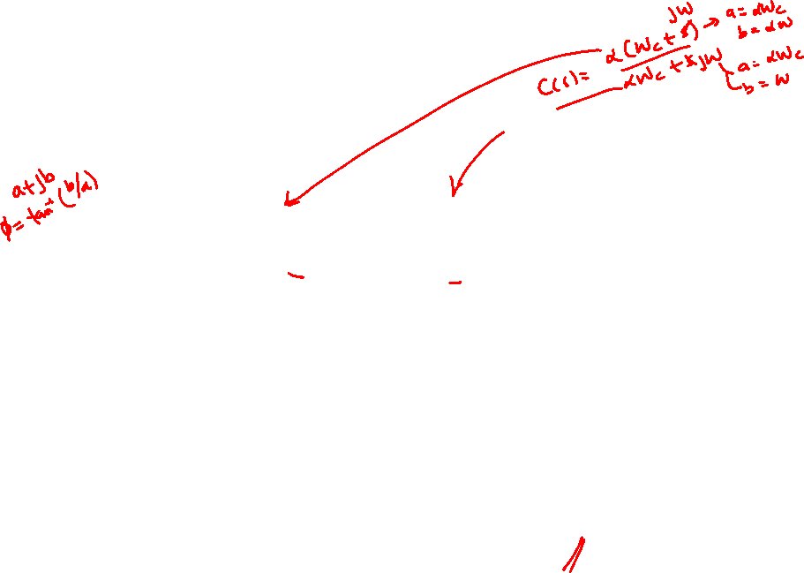
LEAD: Definition
Phase angle is always positive
$$∠C\left(jω\right)=\tan^{−1}{\frac{ω}{ω_{C}}}−\tan^{−1}{\frac{ω}{αω_{C}}}=\tan^{−1}\left[\frac{\frac{ω}{ω_{C}}\left(1−\frac{1}{α}\right)}{1+\frac{ω^{2}}{αω_{C}^{2}}}\right]$$
This is maximum when
$$\left(1+\frac{ω^{2}}{αω_{C}^{2}}\right).\frac{1}{ω_{C}}−\frac{ω}{ω_{C}}.\frac{2ω}{αω_{C}^{2}}=0$$
$$ω^{2}=αω_{C}^{2} ⟹ ω=\sqrt{α}ω_{C}$$
Notes:
Check calculations

Slide 10
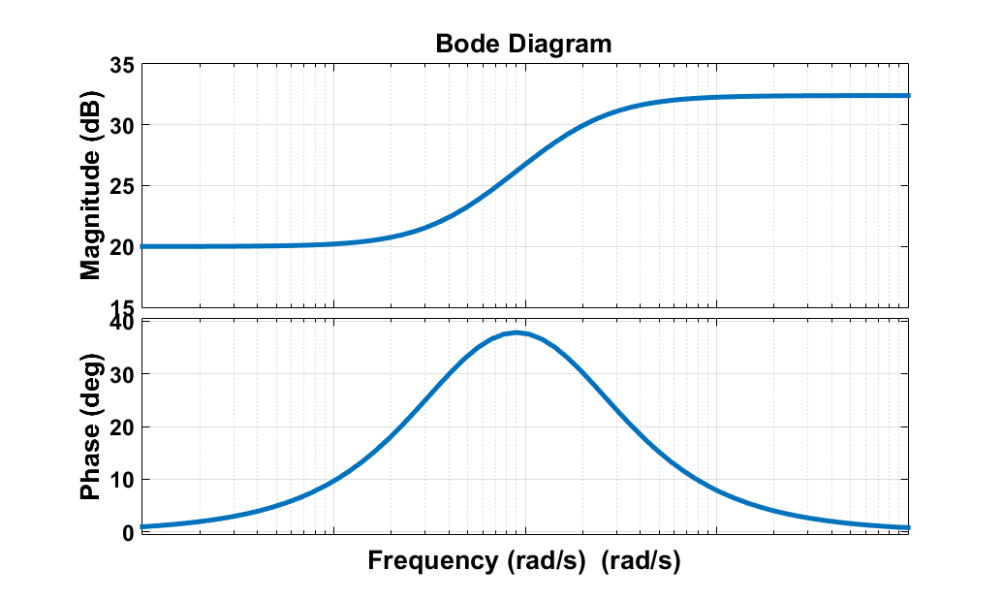

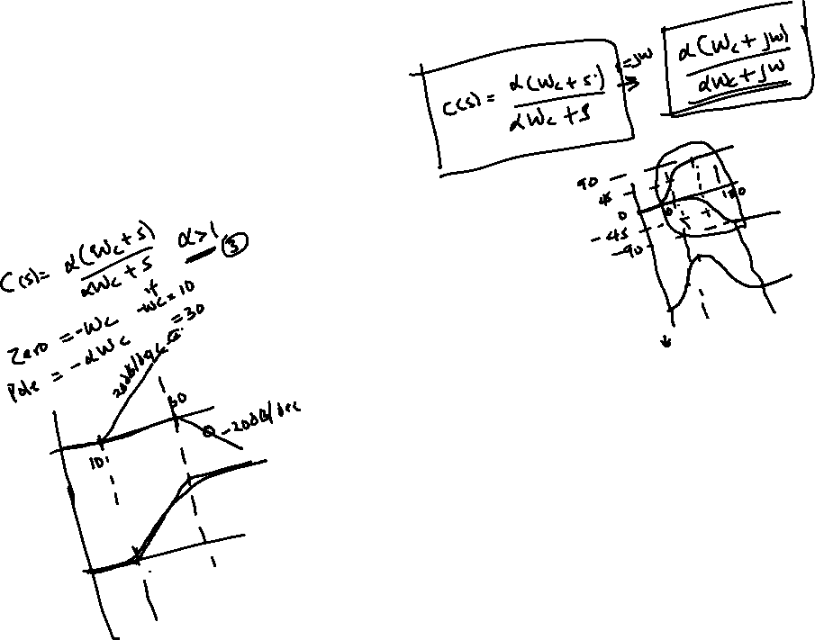
LEAD: Definition
i.e., at the “half-way" point between the two break points in the Bode diagram.
$$φ_{m}=\tan^{−1}\left(\frac{α−1}{2\sqrt{α}}\right)$$
Notes:
Check formula

Slide 11
LEAD compensators
The polar locus of the compensator is a semi-circle (see example of next slide).
At any frequency the gain > 1 (or K if an extra gain is added)
The purpose of the LEAD compensator is to improve the high-frequency behaviour of the system. It increases bandwidth (faster) and phase margins (less resonant).
Control system designers have two variables to choose: α and ω_{c}.
Notes:
Add some colour (or bold)

Slide 12
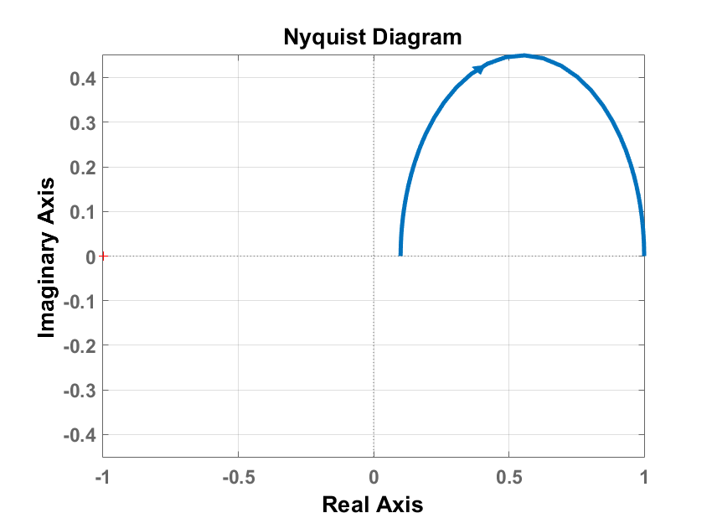

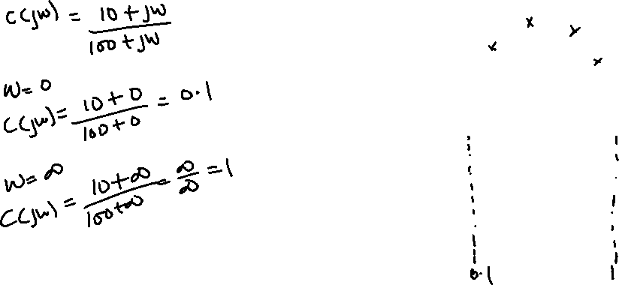
LEAD compensators
$$C\left(s\right)=\frac{10+s}{100+s}$$
Notes:
Consider improving figure.

Slide 13
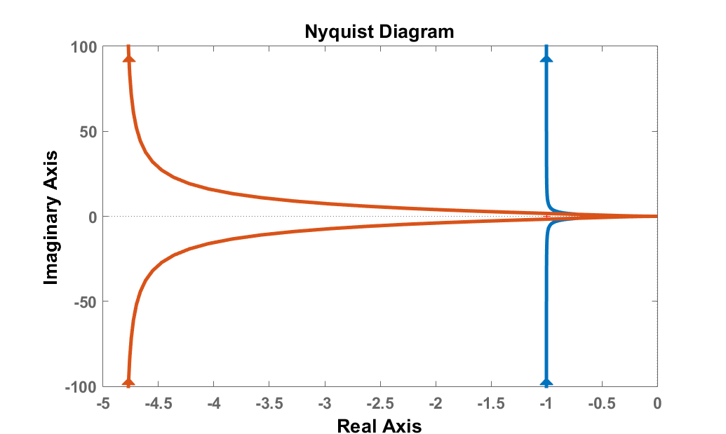
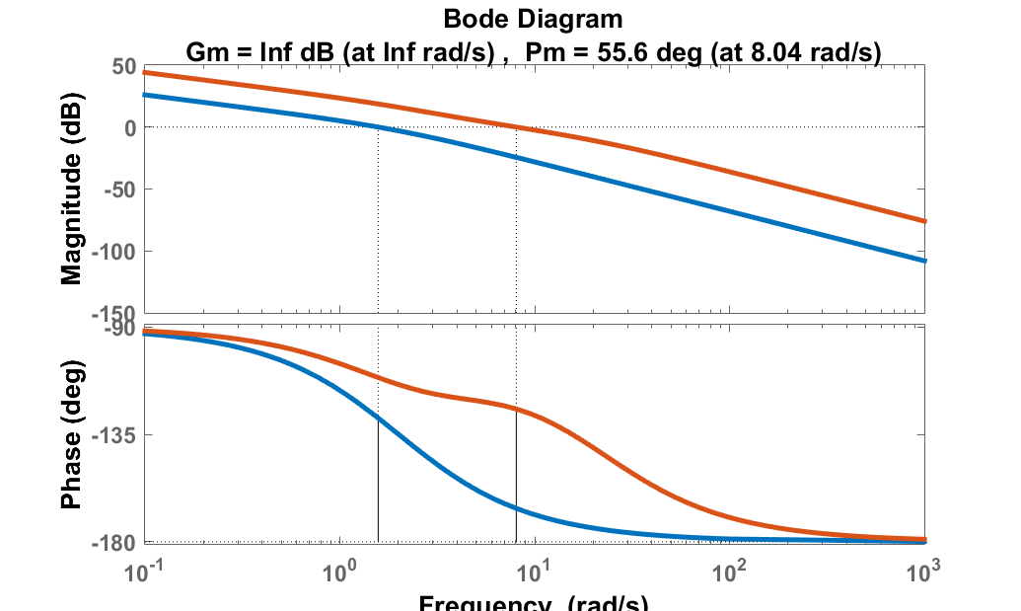
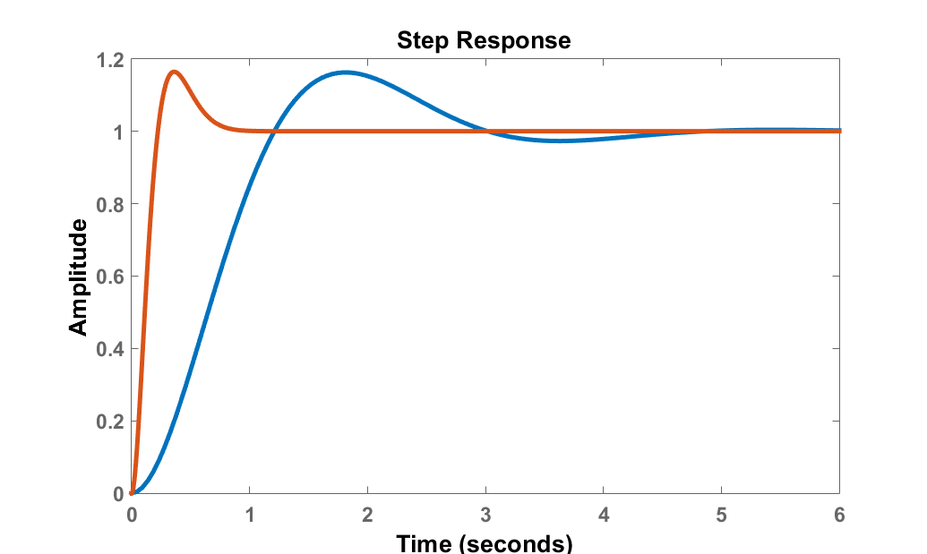
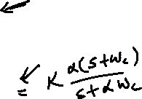

LEAD: Example of impact
$$G\left(s\right)=\frac{4}{s\left(s+2\right)}$$
$$C_{s}\left(s\right)=40\frac{s+4}{s+20}$$
Notes:
OK

Slide 14
LAG Compensators

Slide 15
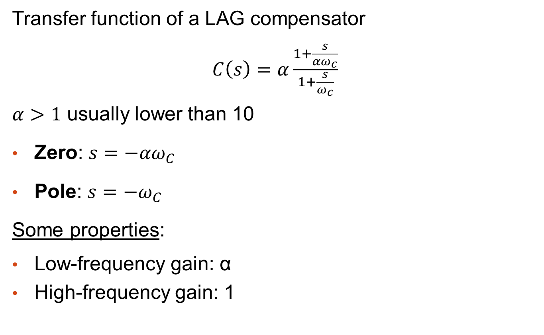
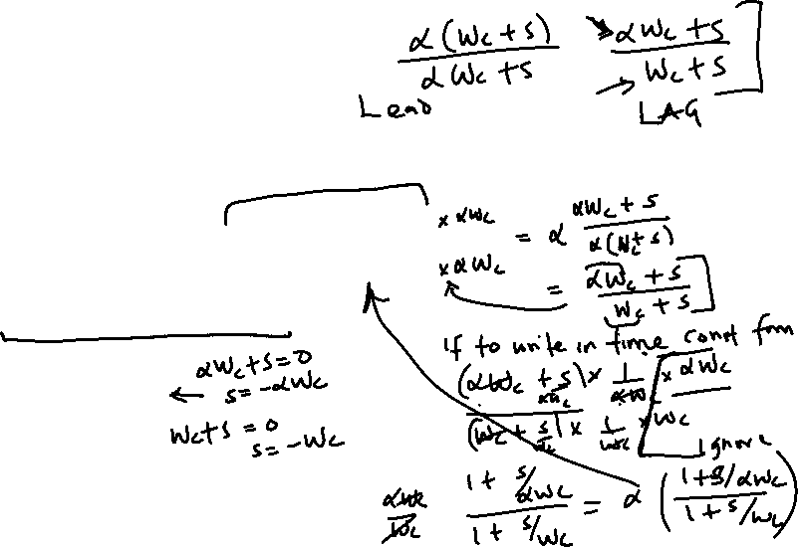
LAG: Definition
Transfer function of a LAG compensator
$C\left(s\right)=α\frac{1+\frac{s}{{αω}_{c}}}{1+\frac{s}{ω_{c}}}$
$α>1$ usually lower than 10
Zero: $s=−{αω}_{C}$
Pole: $s=−ω_{C}$
Some properties:
Low-frequency gain: α
High-frequency gain: 1

Slide 16
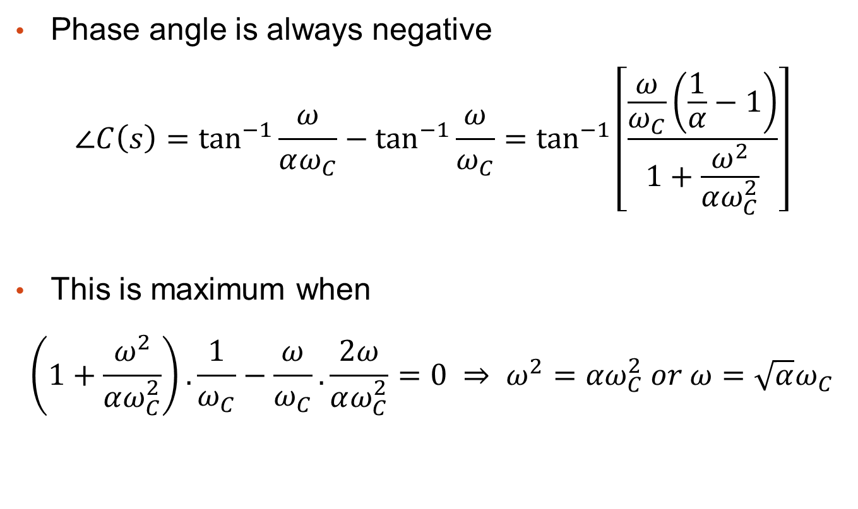
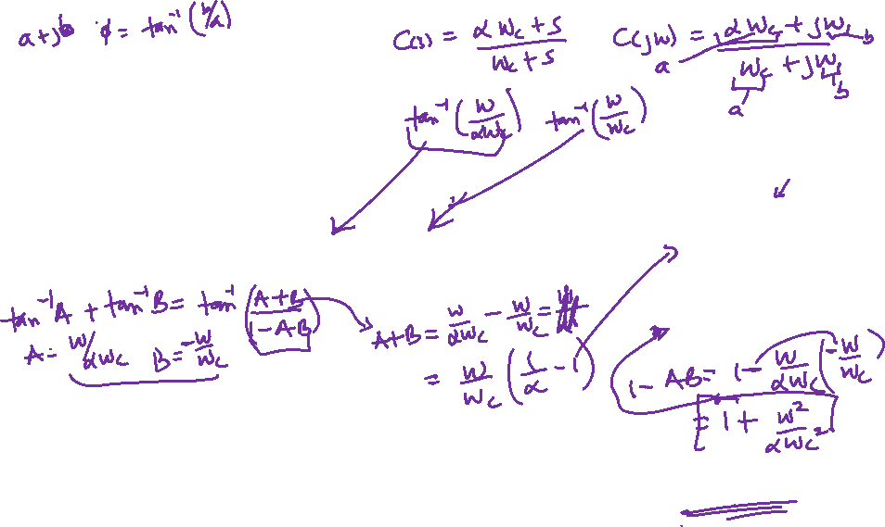
LAG: Definition
Phase angle is always negative
$$∠C\left(s\right)=\tan^{−1}{\frac{ω}{αω_{C}}}−\tan^{−1}{\frac{ω}{ω_{C}}}=\tan^{−1}\left[\frac{\frac{ω}{ω_{C}}\left(\frac{1}{α}−1\right)}{1+\frac{ω^{2}}{αω_{C}^{2}}}\right]$$
This is maximum when
$$\left(1+\frac{ω^{2}}{αω_{C}^{2}}\right).\frac{1}{ω_{C}}−\frac{ω}{ω_{C}}.\frac{2ω}{αω_{C}^{2}}=0 ⇒ ω^{2}={αω}_{C}^{2} or ω=\sqrt{α}ω_{C}$$

Slide 17
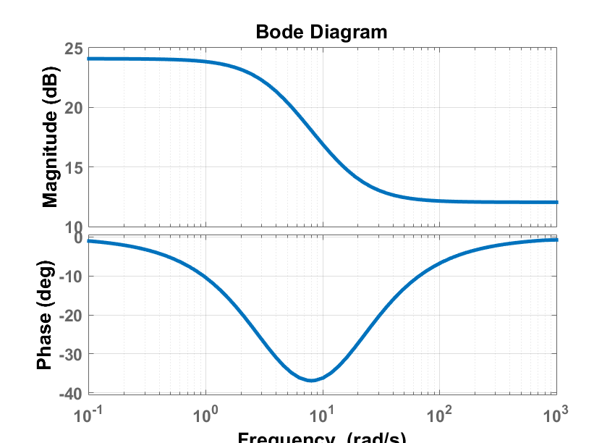

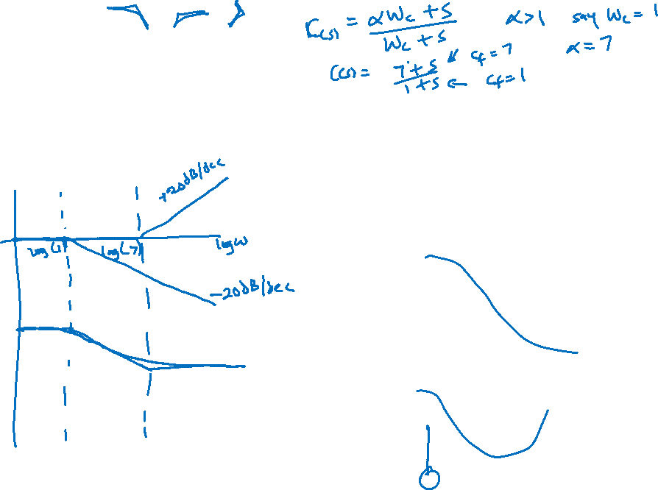
LAG: Definition
i.e., at the “half-way" point between the two break points in the Bode diagram.
$$φ_{max}=\tan^{−1}{\frac{α−1}{2\sqrt{α}}}$$

Slide 18
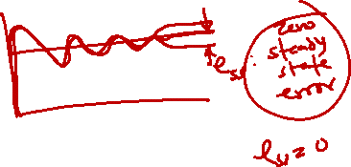
LAG: Definition
The polar locus of the compensator is a semi-circle.
At any frequency the gain > 1
The purpose of the LAG compensator is to improve the low-frequency behaviour of the system. It increases the gain of the system, while preserving approximately the same phase-margin, hence improving steady-state and low frequency performance.
Control system designer has two variables to choose: α and ω_{c}.

Slide 19
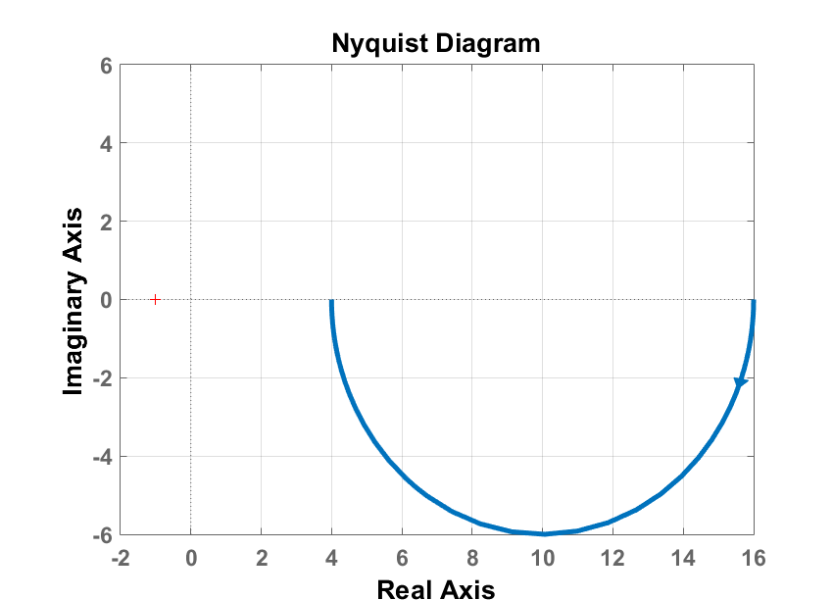

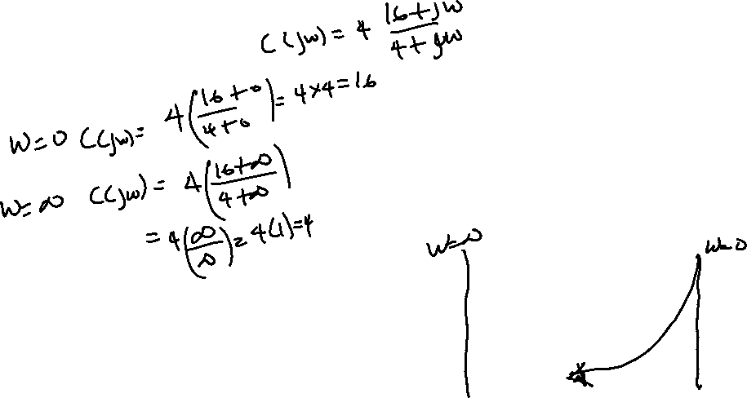
LAG: Example compensators
$$C\left(s\right)=4\frac{16+s}{4+s}$$
Notes:
Redo this figure (improve quality)

Slide 20
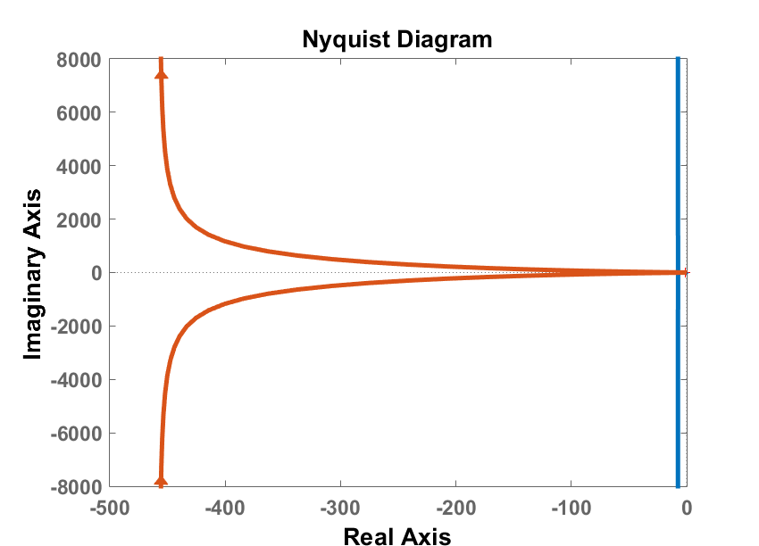
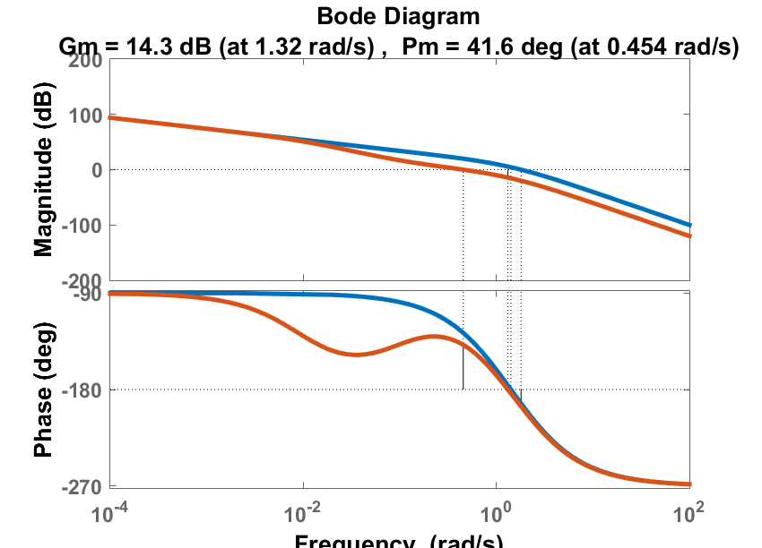
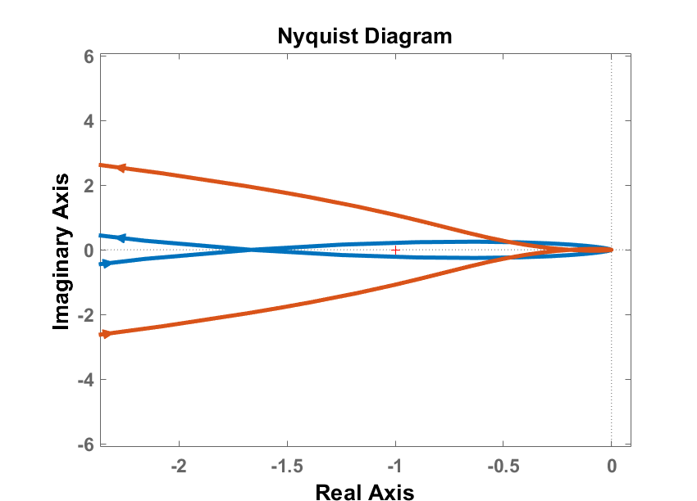

LAG: Example of impact
$$G\left(s\right)=\frac{4}{s\left(s+1\right)\left(0.5s+1\right)}$$
$$C_{s}\left(s\right)=0.1\frac{s+0.1}{s+0.05}$$

Slide 21
LEAD-LAG Compensators

Slide 22

LEAD-LAG compensators
The LAG compensator increases the gain of the open loop for approximately the same phase margin, but at the expense of having a slow mode in the response.
For some systems both the gain and the natural frequency need to be improved. This can be done using LEAD-LAG compensators.

Slide 23
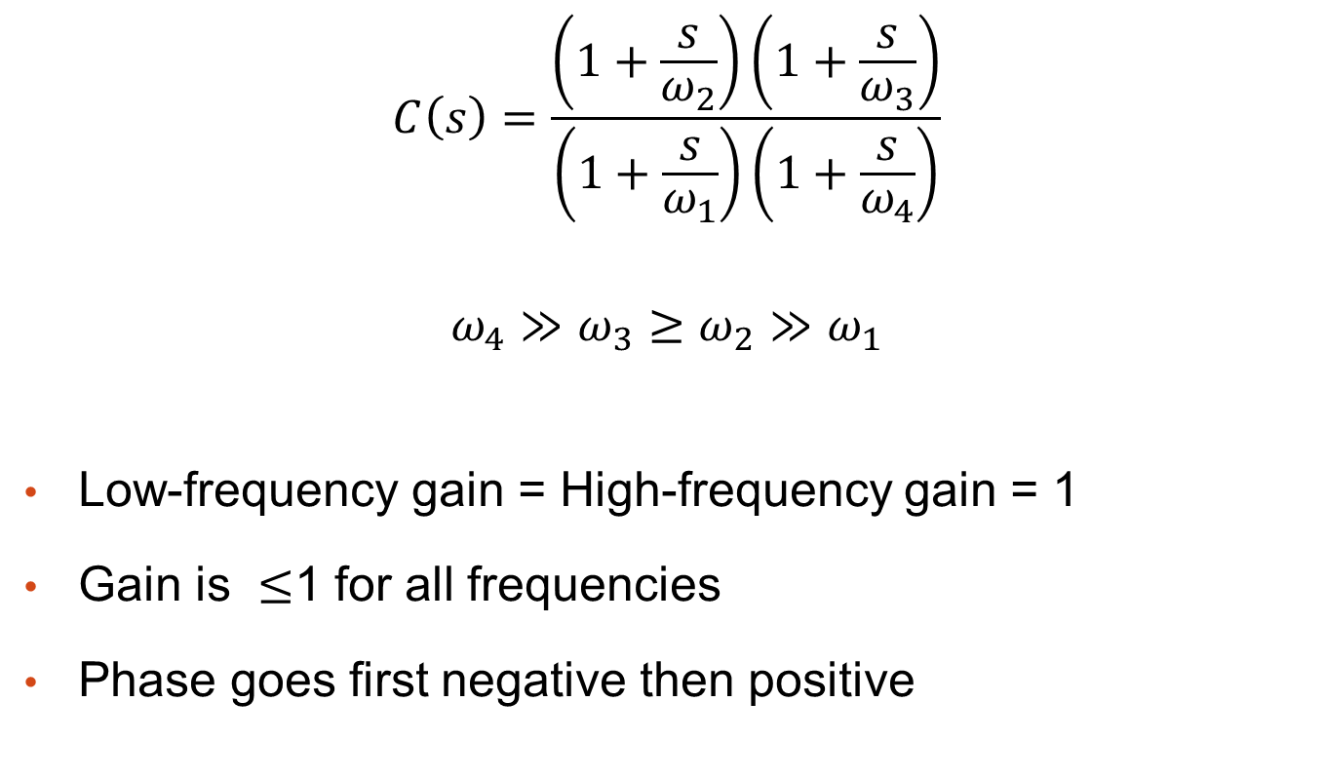
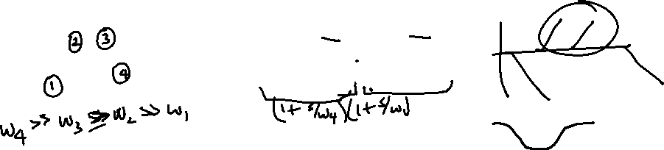
LEAD-LAG compensators
$$C\left(s\right)=\frac{\left(1+\frac{s}{ω_{2}}\right)\left(1+\frac{s}{ω_{3}}\right)}{\left(1+\frac{s}{ω_{1}}\right)\left(1+\frac{s}{ω_{4}}\right)}$$
$$ω_{4}≫ω_{3}≥ω_{2}≫ω_{1}$$
Low-frequency gain = High-frequency gain = 1
Gain is $≤$1 for all frequencies
Phase goes first negative then positive

Slide 24
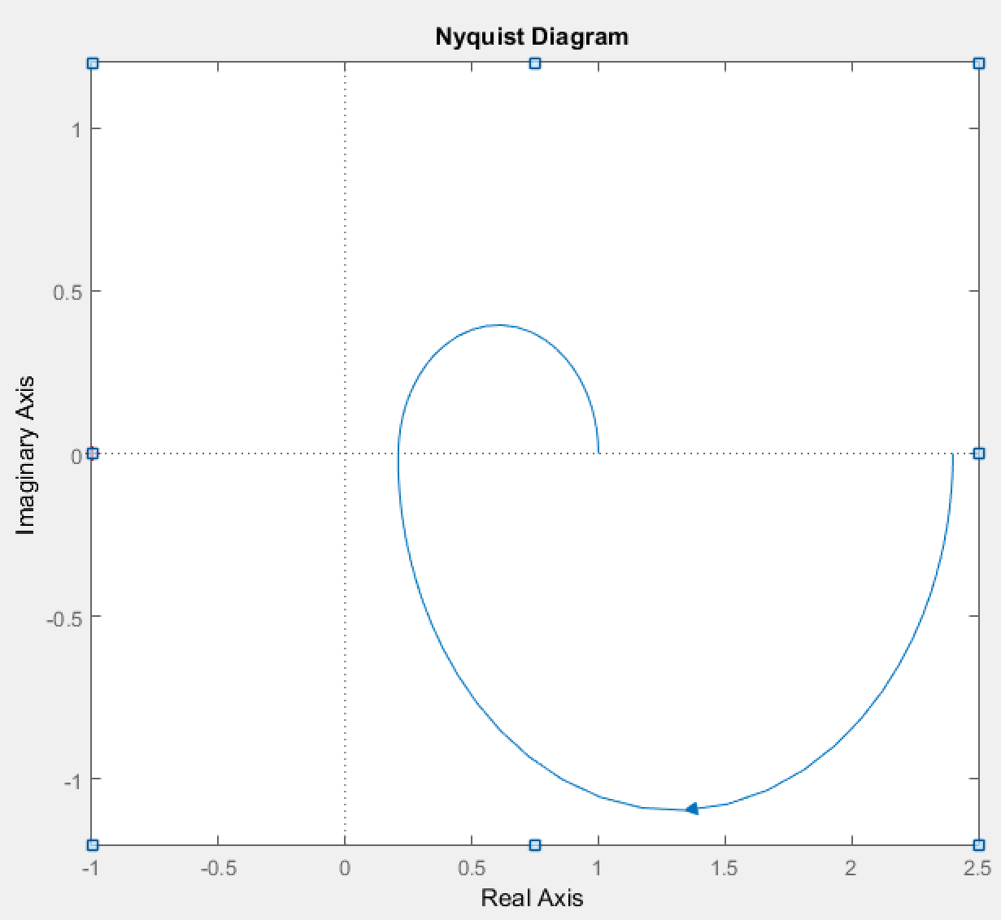


LEAD-LAG compensators
$$C\left(s\right)=\frac{\left(1+\frac{s}{ω_{2}}\right)\left(1+\frac{s}{ω_{3}}\right)}{\left(1+\frac{s}{ω_{1}}\right)\left(1+\frac{s}{ω_{4}}\right)}$$

Slide 25
Conclusion

Slide 26
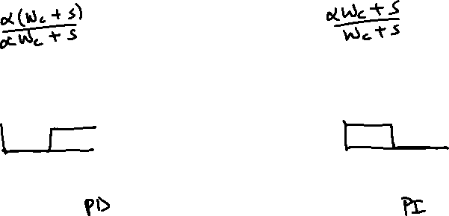
Comparison LEAD and LAG
LEAD Compensator | LAG Compensator
High Pass | Low Pass
Approximates derivative plus proportional control | Approximates integral plus proportional control
Contributes phase lead | Attenuation at high frequencies
Increases gain crossover frequency | Moves gain crossover frequency lower
Increases bandwidth | Reduces bandwidth

Slide 27
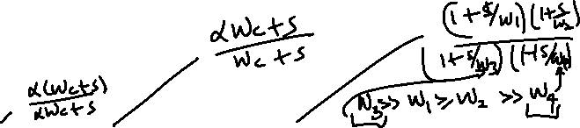
What to remember
Definition of LEAD, LAG and LEAD-LAG compensators
Effect of each compensators
Typical Nyquist plot and Bode diagrams for LEAD and LAG compensators

Slide 28
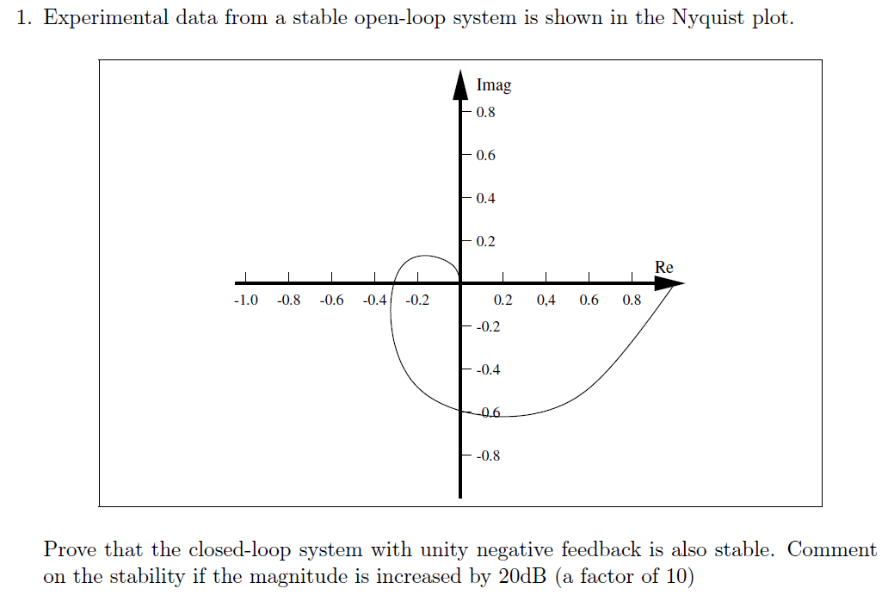
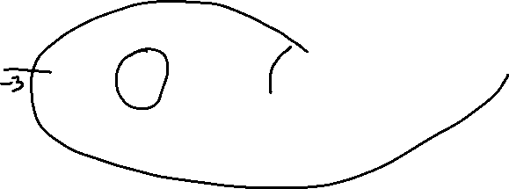
Worked example 1

Slide 29
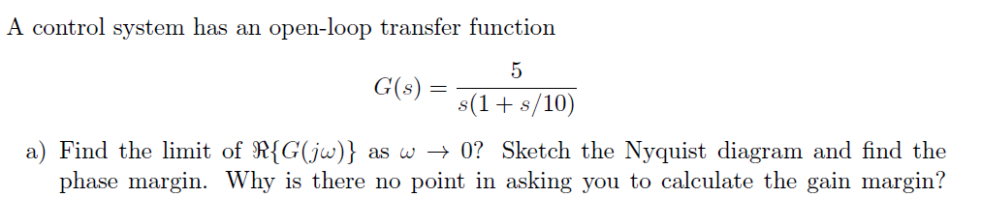

Worked example 2

Slide 30
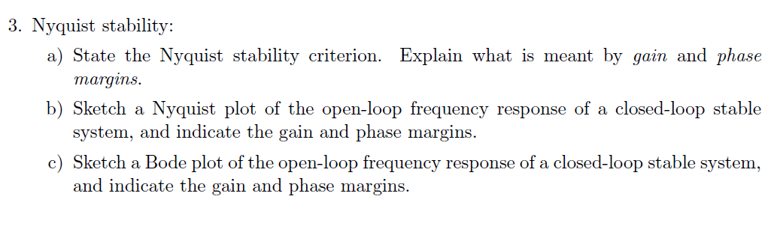
Worked example 3

Slide 31
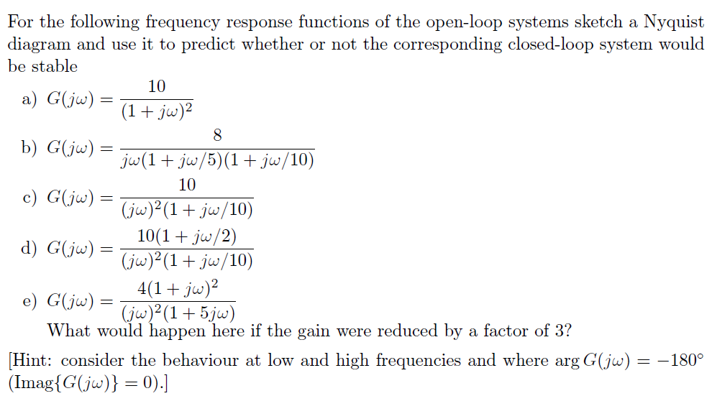
Worked example 4

Slide 32
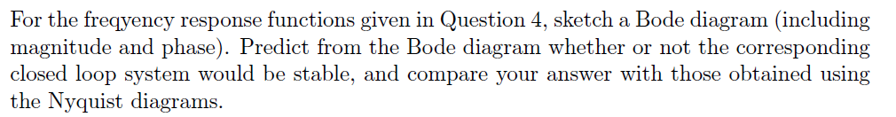
Worked example 5

Slide 33
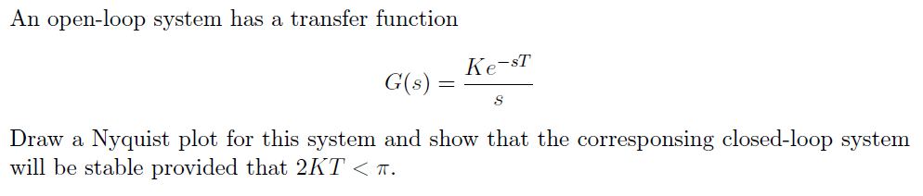
Worked example 6

Slide 34
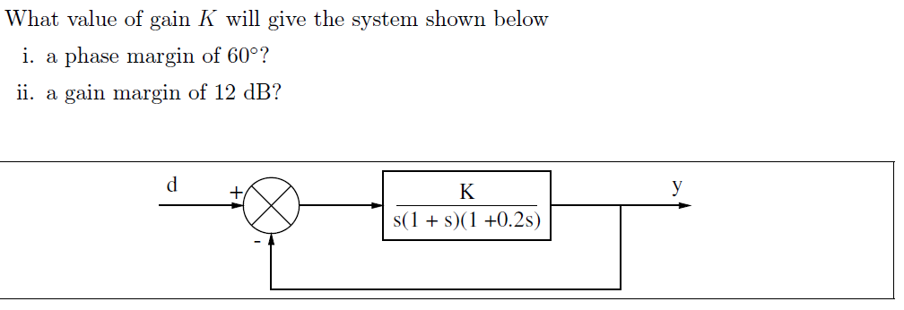
Worked example 7

